Slide 2

DATABASES AND APPLICATIONS
SUBJECT CODE : UQ23CA653A
Samyukta D Kumta
Computer Applications

Slide 3
DATABASES AND APPLICATIONS
UNIT-IV- Database Connection
Database Connectivity-ODBC
MySQL and MS Excel
Install MySQL Connector
Mysql-connector-odbc-8.3.0 winx64
Open ODBC Data app from start window
Add user DSN with user and password
Check for connection
Fetch Database from Mysql

Slide 4
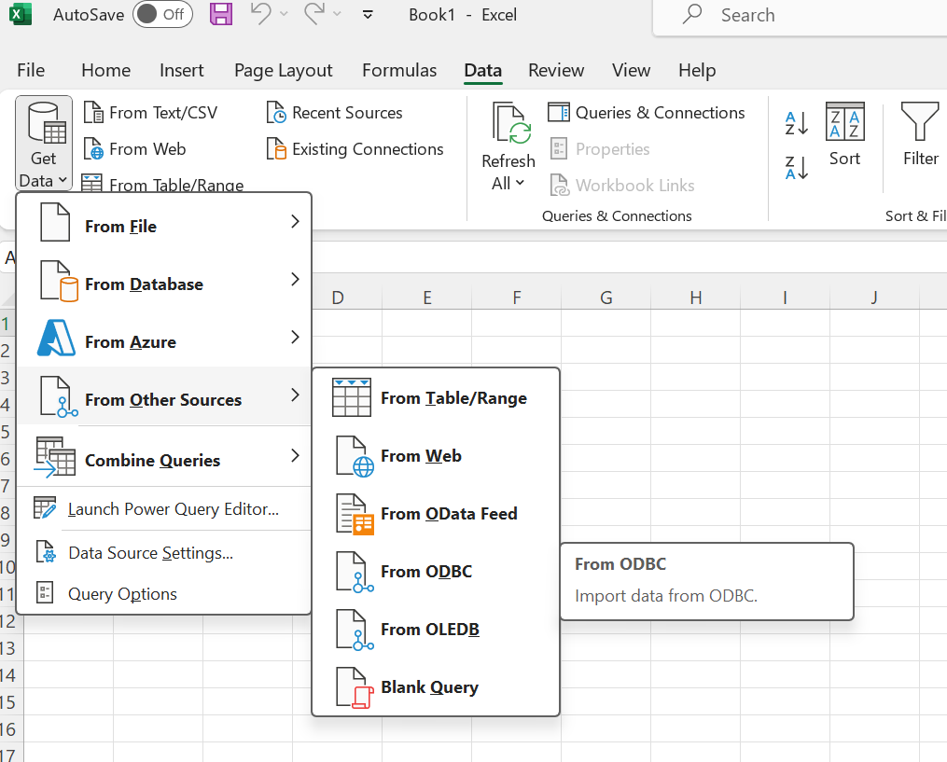
DATABASES AND APPLICATIONS
UNIT-IV- Database Connection
Database Connectivity-ODBC
MySQL and MS Excel

Slide 5
DATABASES AND APPLICATIONS
UNIT-IV- Database Connection
Goto
Start-> Search->ODBC Data source (64bit)
Add MySQL ODBC 8.3 ANSI Driver→ Finish
Set the connection parameter
Enter Username and Password of MySQL Database, Select Database as MySQL → Test Connectivity
Close all windows by click on OK

Slide 6
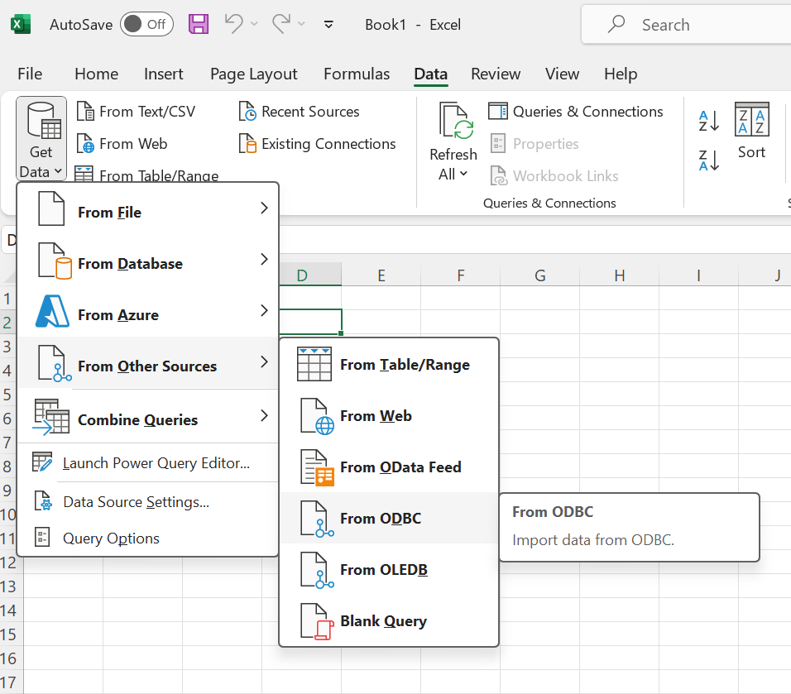
DATABASES AND APPLICATIONS
UNIT-IV- Database Connection
Open Excel

Slide 7
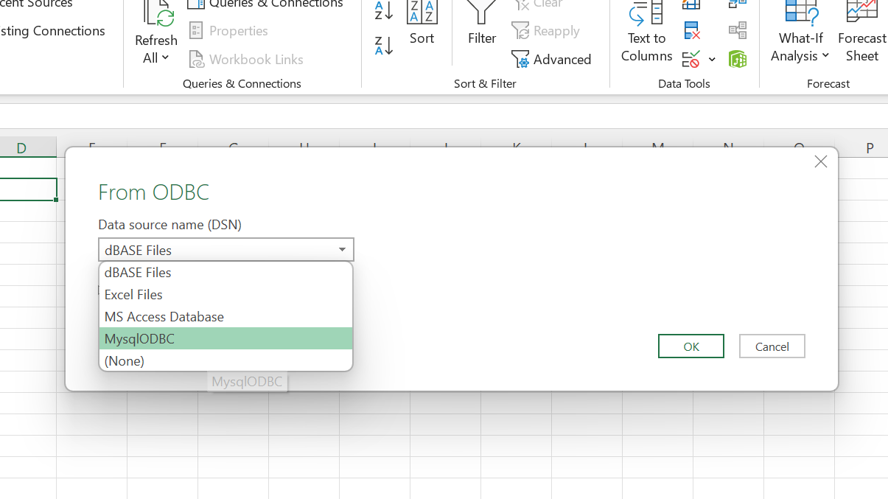
DATABASES AND APPLICATIONS
UNIT-IV- Database Connection
Select DSN

Slide 8
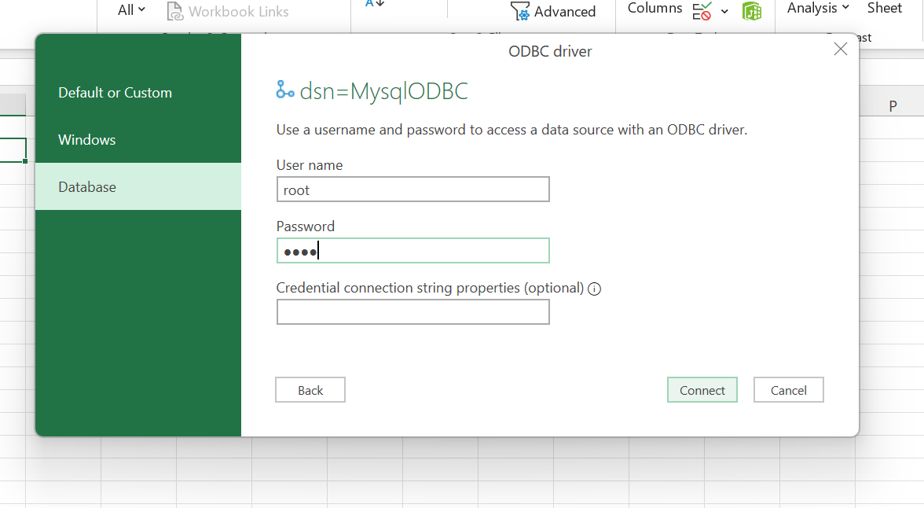
DATABASES AND APPLICATIONS
UNIT-IV- Database Connection
Enter username and password and connect

Slide 9
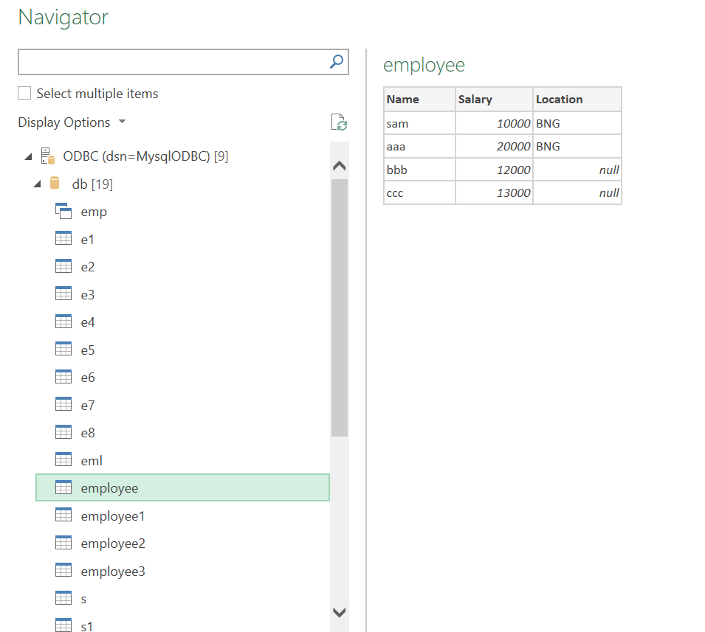
DATABASES AND APPLICATIONS
UNIT-IV- Database Connection
Select Database and table to fetch

Slide 10
DATABASES AND APPLICATIONS
UNIT-IV- Database Connection
Database Connectivity-ODBC
MySQL and Python
Install
→ pip install mysql-connector-python

Slide 11
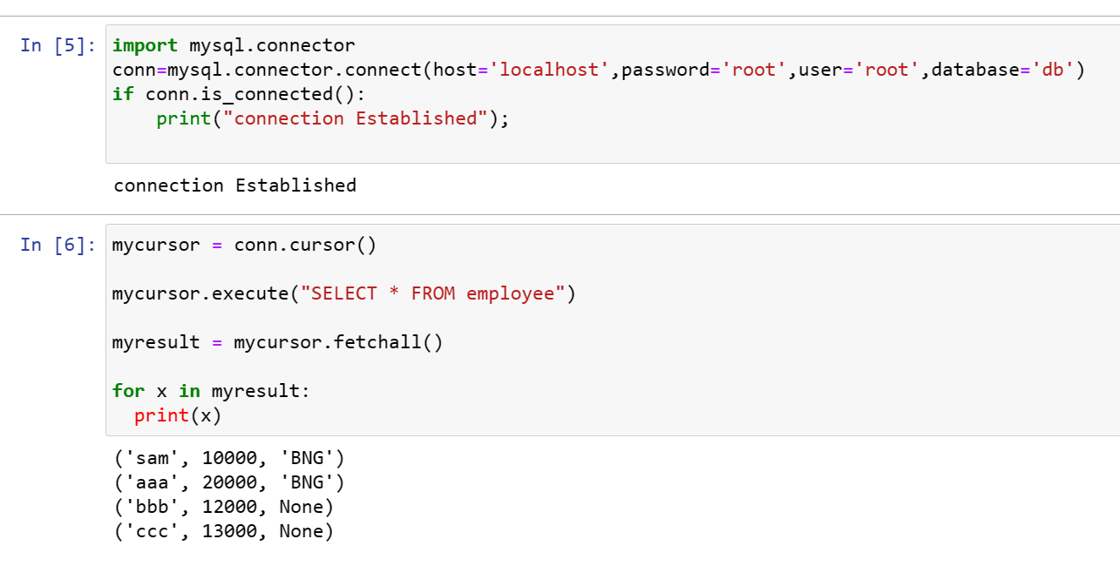
DATABASES AND APPLICATIONS
UNIT-IV- Database Connection

Slide 12

THANK YOU
Samyukta D Kumta
Department of Computer Applications
samyuktad@pes.edu

